Slide 1

AIM-AHEAD Introductory Courses in AI/ML Concepts
Module 6: Natural Language Processing
Text Classification
Adapted from the Health Informatics and Data Science Masters Degree Program, Georgetown University

Slide 2
Text Classification
Convolutional Neural Nets (CNN)

Slide 3
Motivation
We already have word vectors.
Can we use these to come up with a way to represent the sentence and classify it ?
Eg :- “the patient was given immuno therapy”
We have vectors for “the”, “patient”, “was”, “given”, …“therapy”.
How can we use the vectors for words to get vector for sentence ?

Slide 4
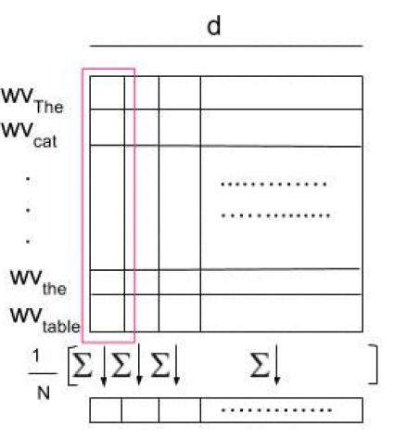
Trivial Approaches
Apply simple reduction techniques to generate vectors/features for the sentence and then apply any well-known ML model (LR, SVM ..)
Mean of word vectors

Slide 5
Fallacies
Different sentences with same words but different ordering will give same vector.
“are you good” vs “you are good”
Negation - opposite meaning but very similar words
“I do want a car” vs “I don’t want a car”
Sentence vector generated via simple operations on word vectors - often do not capture syntactic and semantics properties.

Slide 6
Solution: Convolutional Neural Nets
CovNet or CNN
CNN were initially developed in the neural network image processing community
Recognizing an object from a pre-defined category (e.g., cat, bicycle, etc.).
CNN typically involves two operations, which can be thought of as feature extractors that work on 2D input
convolution
pooling

Slide 7
Convolutional Neural Nets (CNN)
Motivation through Image Classification

Slide 8
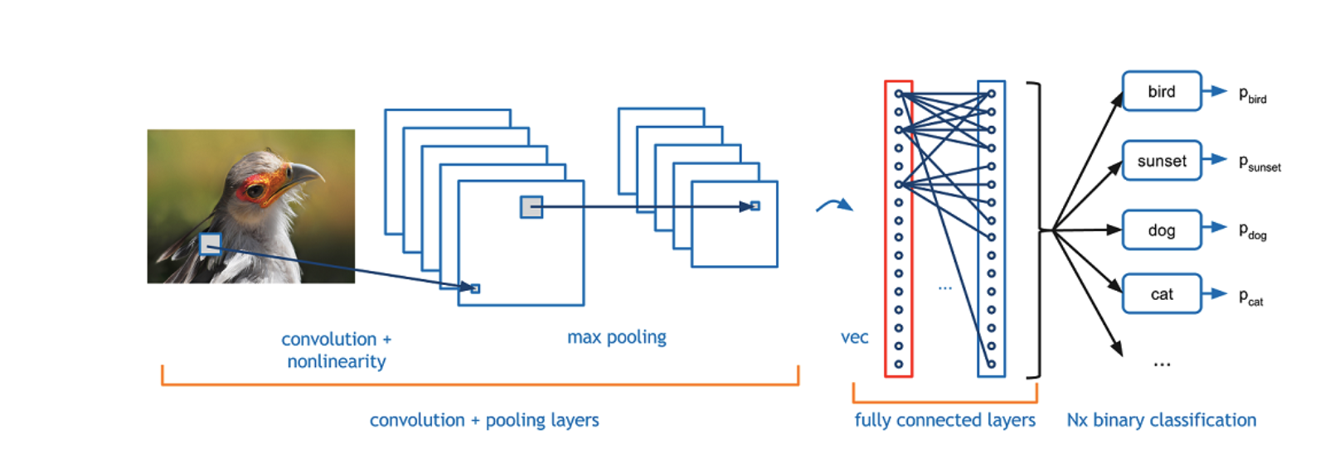
CNN Architecture for Image Classification

Slide 9
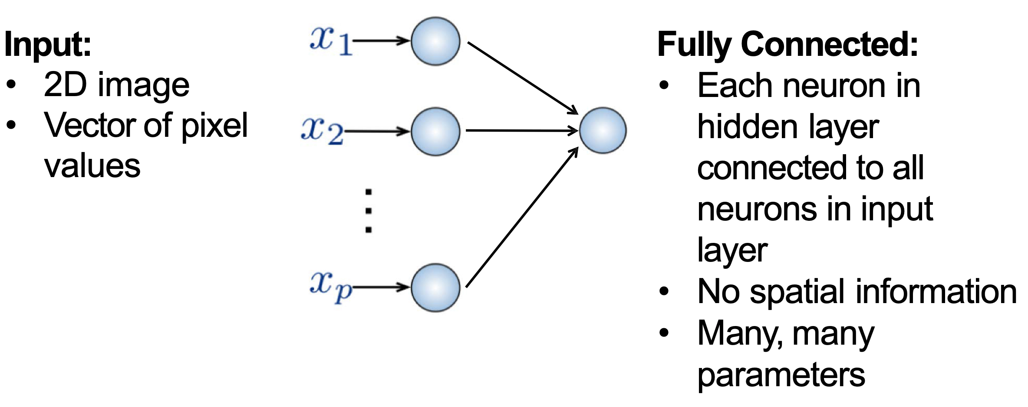
Traditional Fully Connected Neural Network
Use local spatial structure of the 2D input

Slide 10
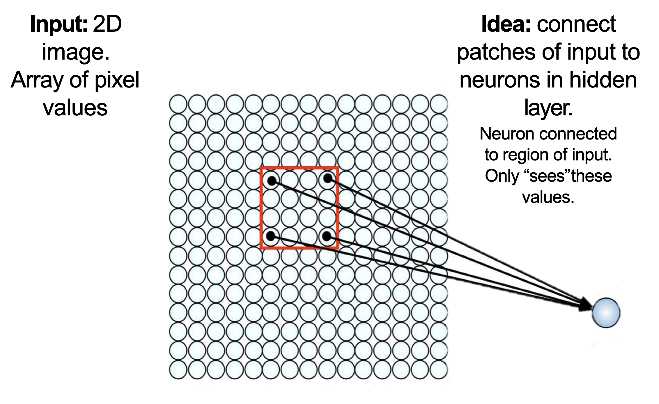
CNN Intuition: Compute Local Spatial features

Slide 11
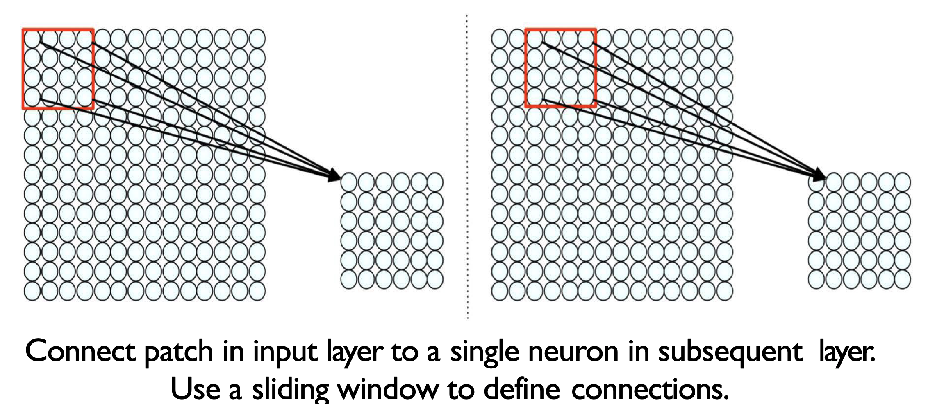
CNN Intuition: Convoluted features

Slide 12
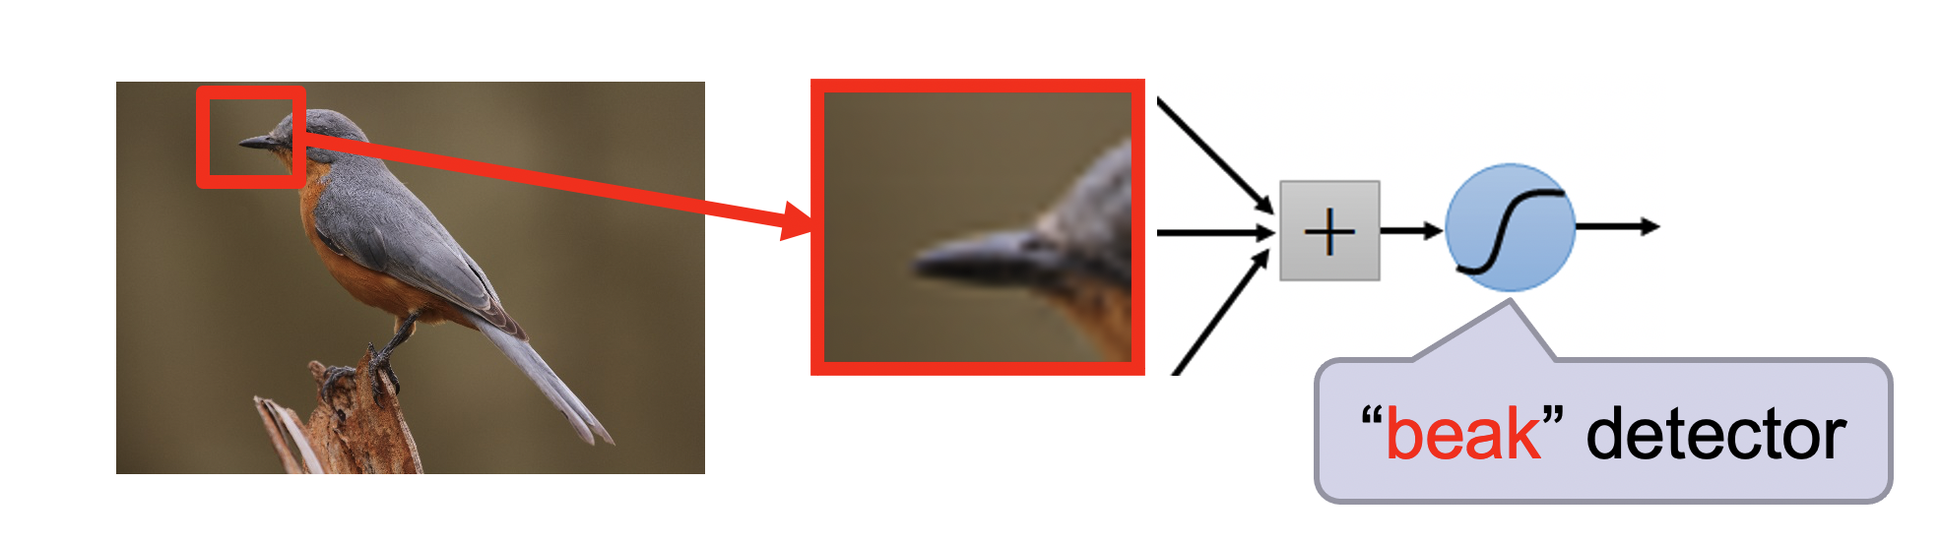
Convoluted features: High Level Feature

Slide 13
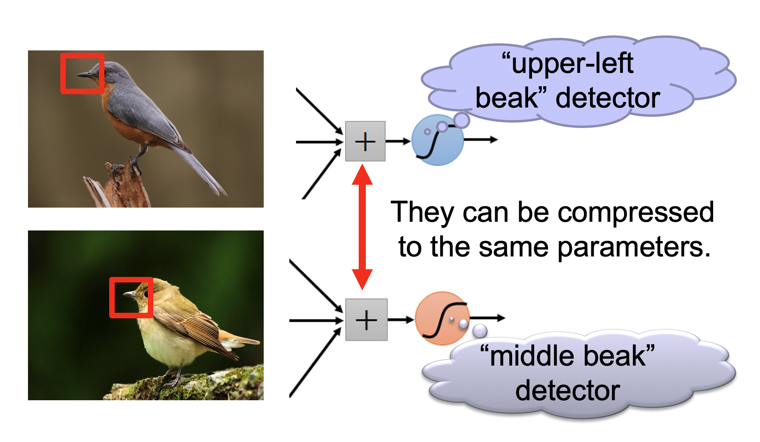
Multiple Convolutions
Hand written digit CNN demo: https://adamharley.com/nn_vis/

Slide 14
Convolution
A filter (2D) of some size slides over the 2D data
This filter is 2D matrix of weights
Each sliding operation => dot product => one scalar value
After all sliding operations => a 2D convoluted feature = > some local feature
Automatic feature generation
Learns some aspects of the input (image, text)

Slide 15
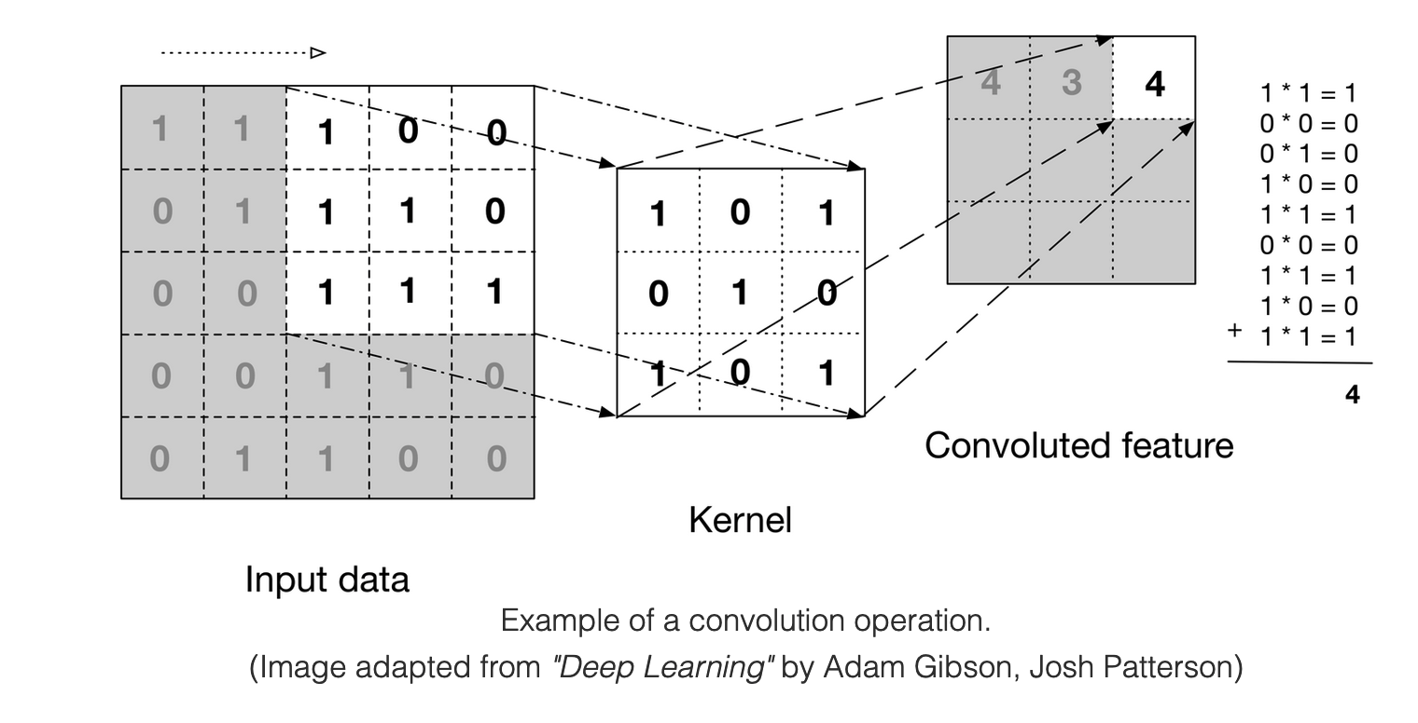
Convolution Example

Slide 16

Sliding operation: Example

Slide 17
Pooling
After obtaining features using convolution, we would next like to use them for classification.
But there will be a lot of convoluted features, because
We typically use a lot of different convolution kernels (128, 256..)
Of different sizes (3, 5, 7 ..)
Learning a classifier with these many convoluted features (typically in millions) is computationally slow and prone to overfitting
Solution: Pooling

Slide 18
Pooling
convolved features => “stationarity” property of a subset of input
Pooling => aggregate statistics of these features at various locations
Compute the mean (or max) value of a particular feature over a region of the image.

Slide 19
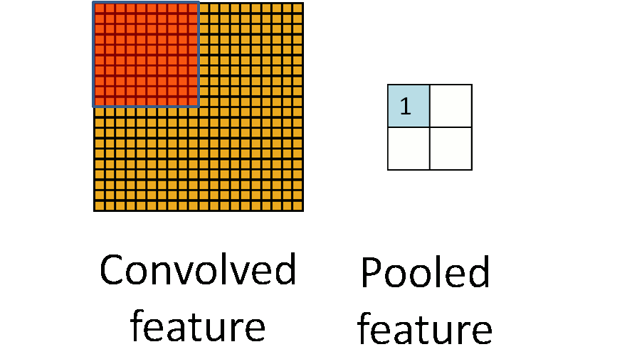
Pooling

Slide 20
CNN for Text classification

Slide 21
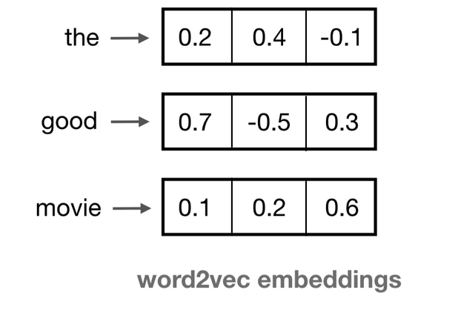
Input: Embedding Space
A 2D matrix, where each word is represented by a fixed dimension vector

Slide 22
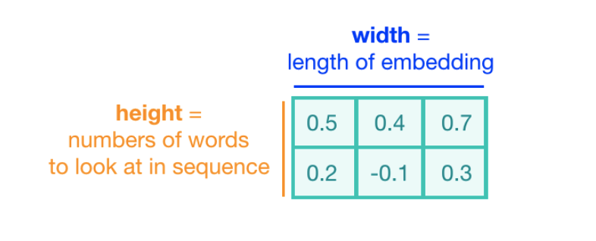
Convolution Kernel
The height of the kernel will be the number of embeddings it will see at once, similar to representing an n-gram in a word model => kernel size (2 here)
The width of the kernel should span the length of an entire word embedding.

Slide 23
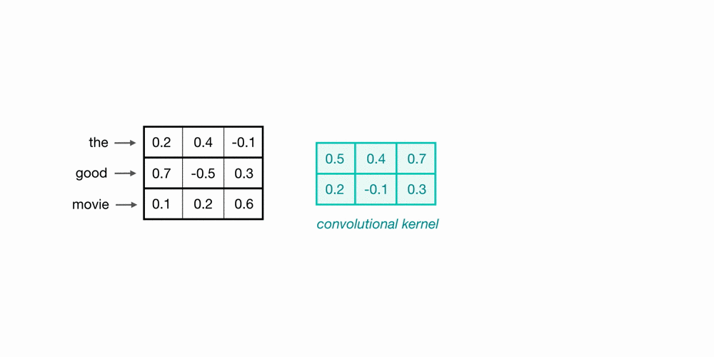
Convolution over Word Sequences
Kernel size = 2
What is this particular convolution step learning?

Slide 24
Convolution over Word Sequences
Kernel size = 2
What is this particular convolution step learning?

Slide 25
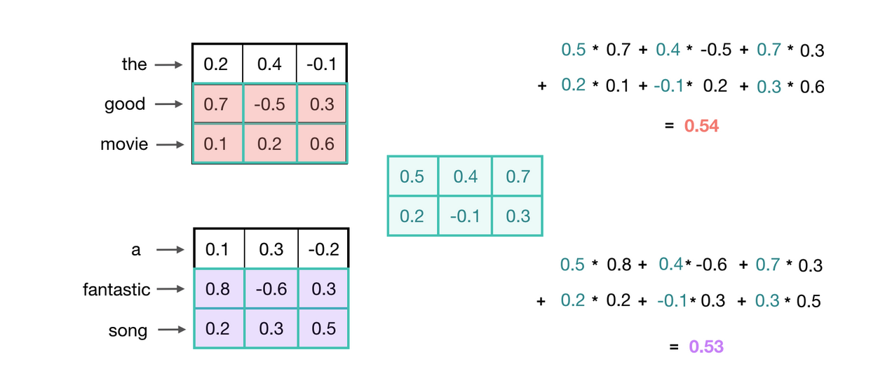
Recognizing General Patterns
Learning 2 grams, which indicative of a positive sentiment?

Slide 26
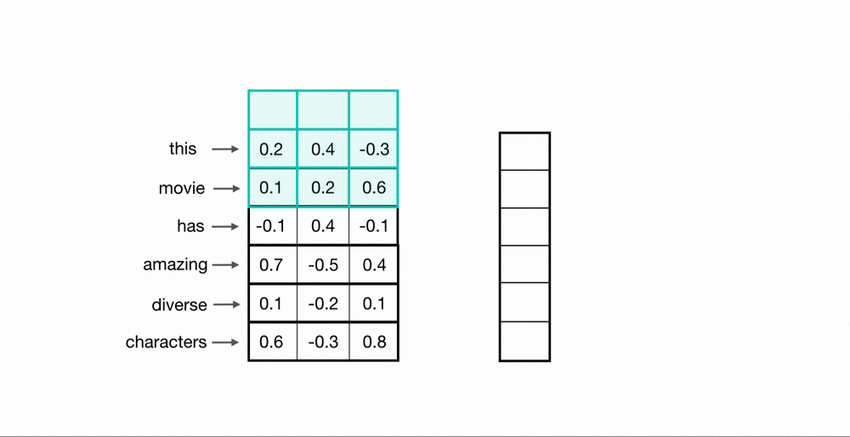
Convolution over the entire sentence

Slide 27
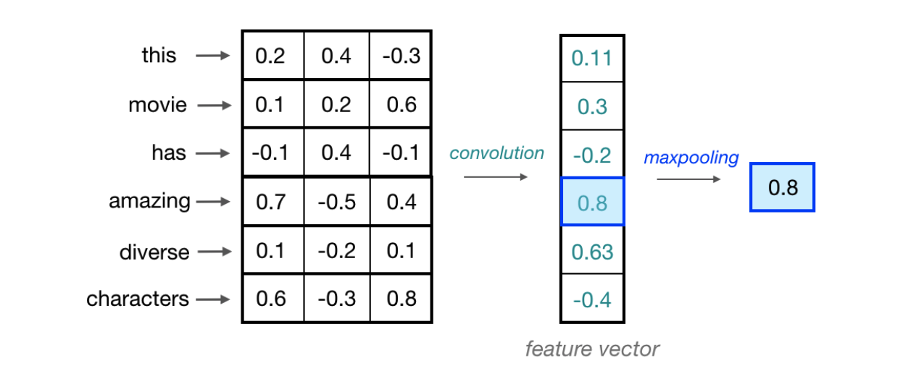
Maxpooling over time

Slide 28
Multiple Kernels
One convolutional kernel is not enough to detect all the different kinds of features that will be useful for a classification task.
Need multiple kernel of different sizes to automatically learn local features
Typical kernel sizes: 3, 5, 7,
Number of kernels: 64, 128, 256, 512

Slide 29
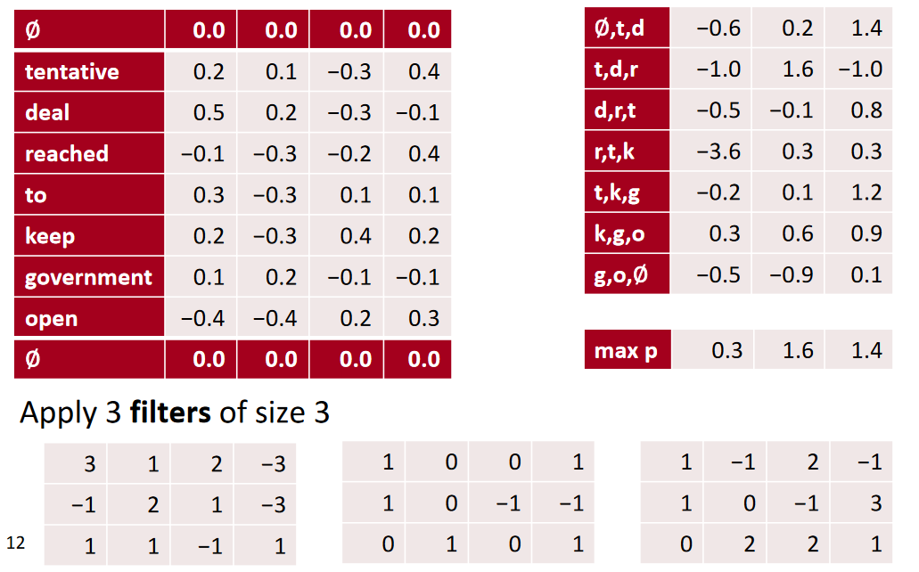
conv1d, padded with max pooling over time

Slide 30
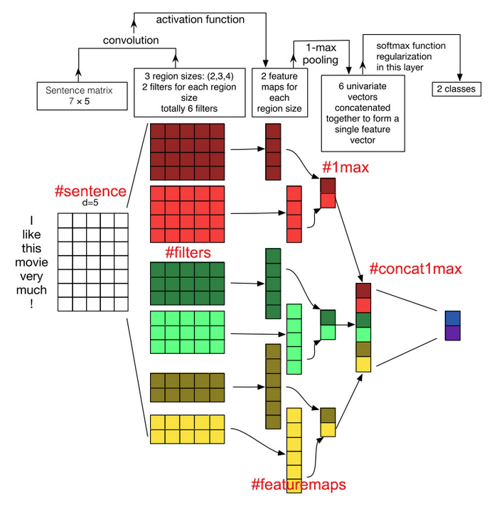

Slide 31
Demo
Lab 8: Text Classification using Neural Networks

